Slide 1
Chapter 3 Selections
Liang, Introduction to Java Programming, Eighth Edition, (c) 2011 Pearson Education, Inc. All rights reserved. 0132130807

Slide 2
The boolean Type and Operators
Often in a program you need to compare two values, such as whether i is greater than j. Java provides six comparison operators (also known as relational operators) that can be used to compare two values. The result of the comparison is a Boolean value: true or false.
boolean b = (1 > 2);

Slide 3
Comparison Operators
Operator Name
< less than
<= less than or equal to
> greater than
>= greater than or equal to
== equal to
!= not equal to

Slide 4
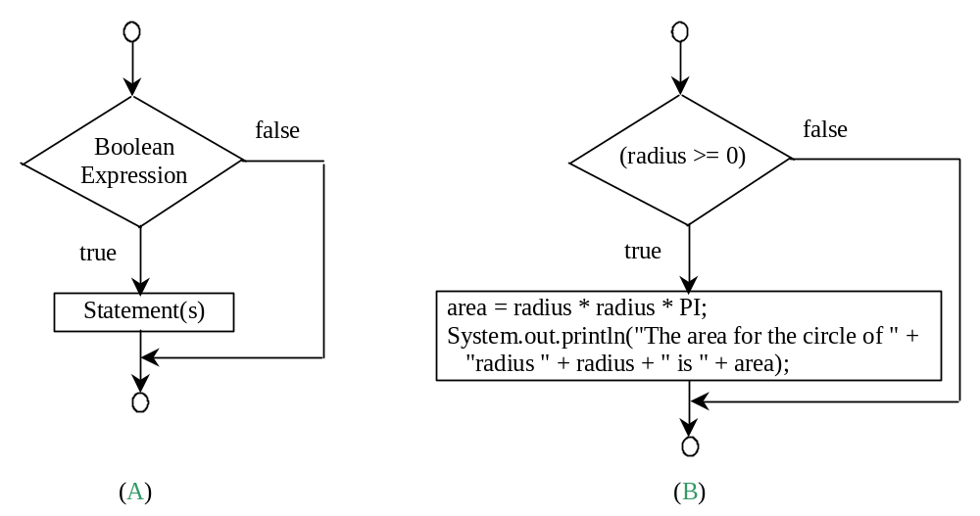
One-way if Statements
if (radius >= 0) {
area = radius * radius * PI;
System.out.println("The area for the circle of radius "
+ radius + " is " + area);
}
if (boolean-expression) {
statement(s);
}

Slide 5


Note

Slide 6
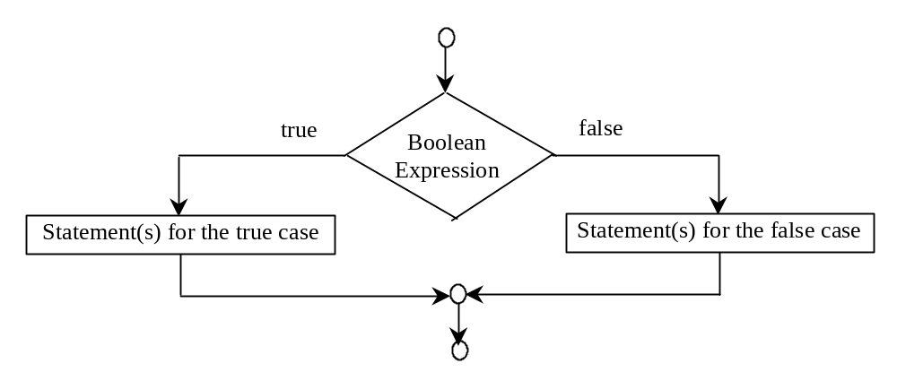
The Two-way if Statement
if (boolean-expression) {
statement(s)-for-the-true-case;
}
else {
statement(s)-for-the-false-case;
}

Slide 7
if...else Example
if (radius >= 0) {
area = radius * radius * 3.14159;
System.out.println("The area for the “
+ “circle of radius " + radius +
" is " + area);
}
else {
System.out.println("Negative input");
}

Slide 8
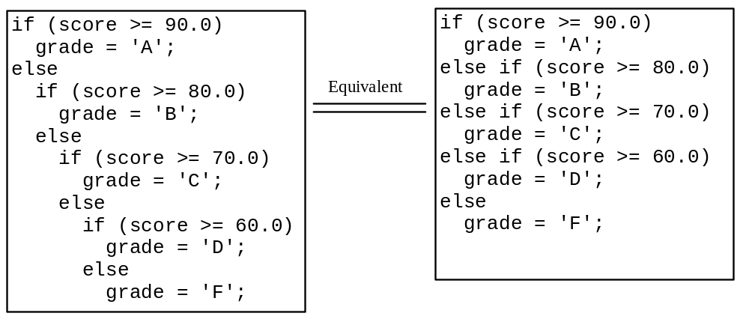
Multiple Alternative if Statements

Slide 9
Trace if-else statement
animation
Suppose score is 70.0
The condition is false
if (score >= 90.0)
grade = 'A';
else if (score >= 80.0)
grade = 'B';
else if (score >= 70.0)
grade = 'C';
else if (score >= 60.0)
grade = 'D';
else
grade = 'F';

Slide 10
Trace if-else statement
animation
Suppose score is 70.0
The condition is false
if (score >= 90.0)
grade = 'A';
else if (score >= 80.0)
grade = 'B';
else if (score >= 70.0)
grade = 'C';
else if (score >= 60.0)
grade = 'D';
else
grade = 'F';

Slide 11
Trace if-else statement
animation
Suppose score is 70.0
The condition is true
if (score >= 90.0)
grade = 'A';
else if (score >= 80.0)
grade = 'B';
else if (score >= 70.0)
grade = 'C';
else if (score >= 60.0)
grade = 'D';
else
grade = 'F';

Slide 12
Trace if-else statement
animation
Suppose score is 70.0
grade is C
if (score >= 90.0)
grade = 'A';
else if (score >= 80.0)
grade = 'B';
else if (score >= 70.0)
grade = 'C';
else if (score >= 60.0)
grade = 'D';
else
grade = 'F';

Slide 13
Trace if-else statement
animation
Suppose score is 70.0
Exit the if statement
if (score >= 90.0)
grade = 'A';
else if (score >= 80.0)
grade = 'B';
else if (score >= 70.0)
grade = 'C';
else if (score >= 60.0)
grade = 'D';
else
grade = 'F';

Slide 14
Common Errors
Adding a semicolon at the end of an if clause is a common mistake.
if (radius >= 0);
{
area = radius*radius*PI;
System.out.println(
"The area for the circle of radius " +
radius + " is " + area);
}
This mistake is hard to find, because it is not a compilation error or a runtime error, it is a logic error.
This error often occurs when you use the next-line block style.
Wrong

Slide 15
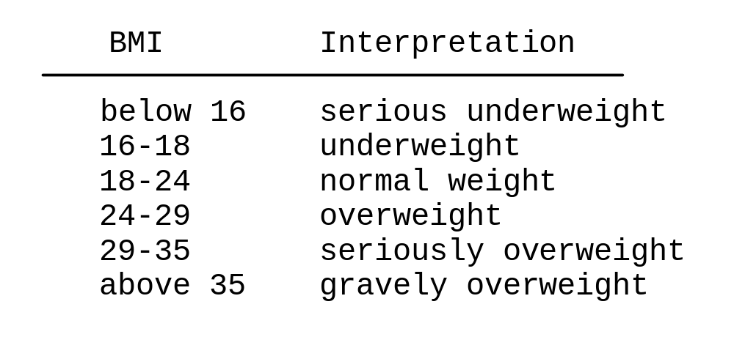

Problem: Body Mass Index
Body Mass Index (BMI) is a measure of health on weight. It can be calculated by taking your weight in kilograms and dividing by the square of your height in meters. The interpretation of BMI for people 16 years or older is as follows:
ComputeBMI

Slide 16
Logical Operators
Operator Name
! not
&& and
|| or
^ exclusive or

Slide 17
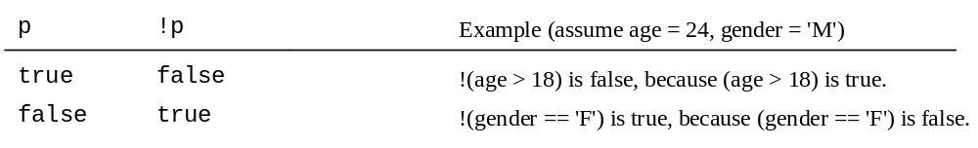
Truth Table for Operator !

Slide 18
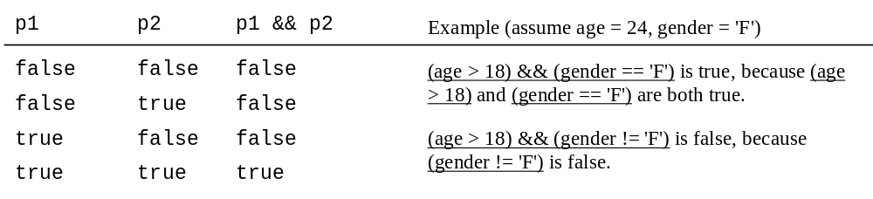
Truth Table for Operator &&

Slide 19
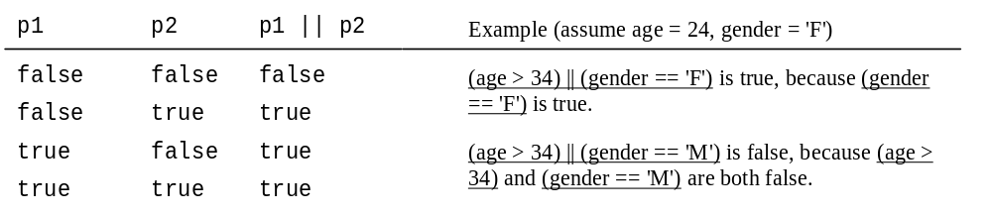
Truth Table for Operator ||

Slide 20
Examples
Here is a program that checks whether a number is divisible by 2 and 3, whether a number is divisible by 2 or 3, and whether a number is divisible by 2 or 3 but not both:
TestBooleanOperators
Run

Slide 21
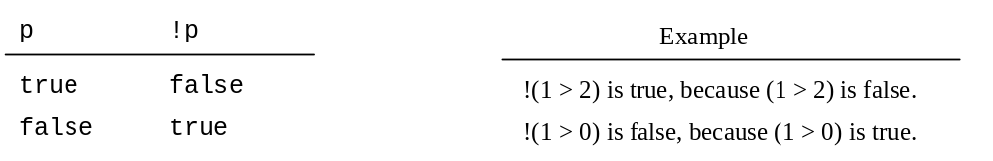
Truth Table for Operator !

Slide 22
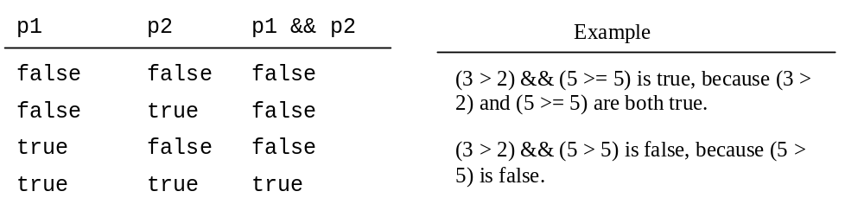
Truth Table for Operator &&

Slide 23
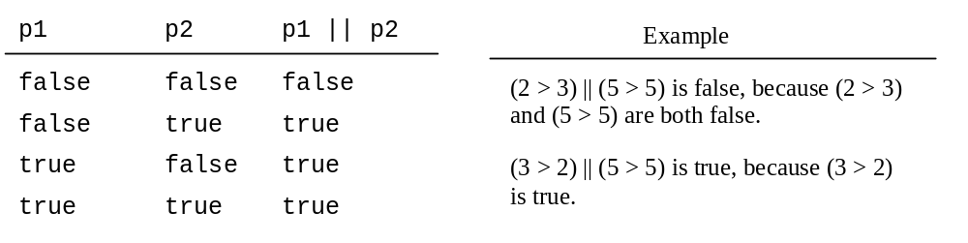
Truth Table for Operator ||

Slide 24
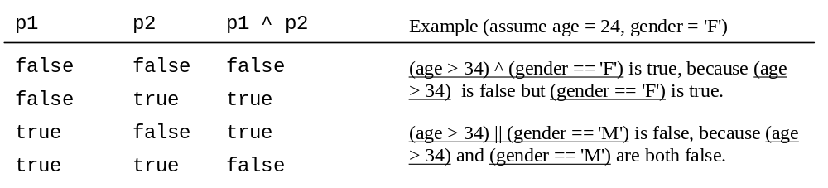
Truth Table for Operator ^

Slide 25
Problem: Lottery
Write a program that randomly generates a lottery of a two-digit number, prompts the user to enter a two-digit number, and determines whether the user wins according to the following rule:
If the user input matches the lottery in exact order, the award is $10,000.
If the user input matches the lottery, the award is $3,000.
If one digit in the user input matches a digit in the lottery, the award is $1,000.
Lottery

Slide 26
switch Statements
switch (status) {
case 0: compute taxes for single filers;
break;
case 1: compute taxes for married file jointly;
break;
case 2: compute taxes for married file separately;
break;
case 3: compute taxes for head of household;
break;
default: System.out.println("Errors: invalid status");
System.exit(0);
}

Slide 27
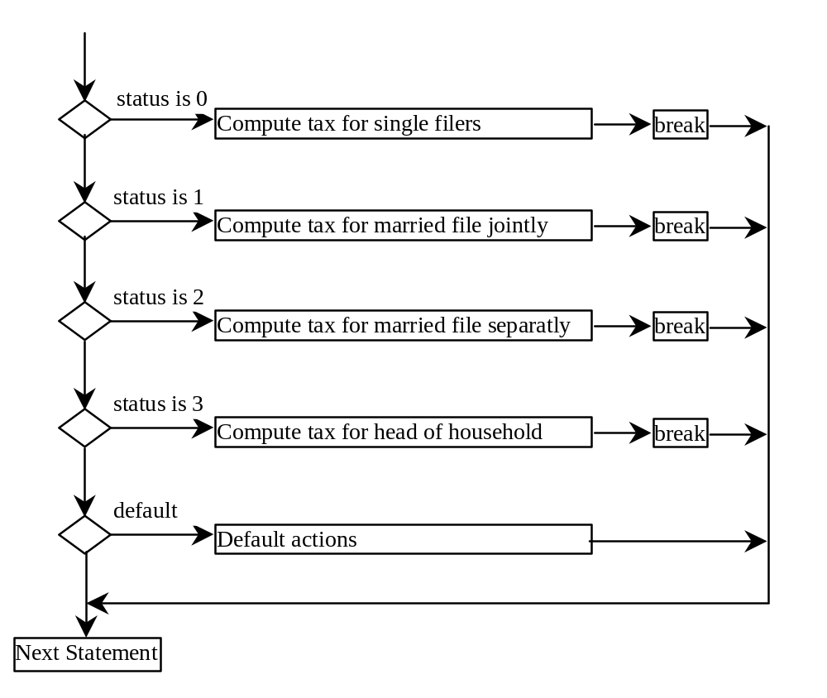
switch Statement Flow Chart

Slide 28
switch Statement Rules
The switch-expression must yield a value of char, byte, short, or int type and must always be enclosed in parentheses.
switch (switch-expression) {
case value1: statement(s)1;
break;
case value2: statement(s)2;
break;
…
case valueN: statement(s)N;
break;
default: statement(s)-for-default;
}
The value1, ..., and valueN must have the same data type as the value of the switch-expression. The resulting statements in the case statement are executed when the value in the case statement matches the value of the switch-expression. Note that value1, ..., and valueN are constant expressions, meaning that they cannot contain variables in the expression, such as 1 + x.

Slide 29
switch Statement Rules
The keyword break is optional, but it should be used at the end of each case in order to terminate the remainder of the switch statement. If the break statement is not present, the next case statement will be executed.
switch (switch-expression) {
case value1: statement(s)1;
break;
case value2: statement(s)2;
break;
…
case valueN: statement(s)N;
break;
default: statement(s)-for-default;
}
The default case, which is optional, can be used to perform actions when none of the specified cases matches the switch-expression.
The case statements are executed in sequential order, but the order of the cases (including the default case) does not matter. However, it is good programming style to follow the logical sequence of the cases and place the default case at the end.

Slide 30
Trace switch statement
animation
Suppose ch is 'a':
switch (ch) {
case 'a': System.out.println(ch);
case 'b': System.out.println(ch);
case 'c': System.out.println(ch);
}

Slide 31
Trace switch statement
animation
ch is 'a':
switch (ch) {
case 'a': System.out.println(ch);
case 'b': System.out.println(ch);
case 'c': System.out.println(ch);
}

Slide 32
Trace switch statement
animation
Execute this line
switch (ch) {
case 'a': System.out.println(ch);
case 'b': System.out.println(ch);
case 'c': System.out.println(ch);
}

Slide 33
Trace switch statement
animation
Execute this line
switch (ch) {
case 'a': System.out.println(ch);
case 'b': System.out.println(ch);
case 'c': System.out.println(ch);
}

Slide 34
Trace switch statement
animation
Execute this line
switch (ch) {
case 'a': System.out.println(ch);
case 'b': System.out.println(ch);
case 'c': System.out.println(ch);
}

Slide 35
Trace switch statement
animation
Execute next statement
switch (ch) {
case 'a': System.out.println(ch);
case 'b': System.out.println(ch);
case 'c': System.out.println(ch);
}
Next statement;

Slide 36
Trace switch statement
animation
Suppose ch is 'a':
switch (ch) {
case 'a': System.out.println(ch);
break;
case 'b': System.out.println(ch);
break;
case 'c': System.out.println(ch);
}

Slide 37
Trace switch statement
animation
ch is 'a':
switch (ch) {
case 'a': System.out.println(ch);
break;
case 'b': System.out.println(ch);
break;
case 'c': System.out.println(ch);
}

Slide 38
Trace switch statement
animation
Execute this line
switch (ch) {
case 'a': System.out.println(ch);
break;
case 'b': System.out.println(ch);
break;
case 'c': System.out.println(ch);
}

Slide 39
Trace switch statement
animation
Execute this line
switch (ch) {
case 'a': System.out.println(ch);
break;
case 'b': System.out.println(ch);
break;
case 'c': System.out.println(ch);
}

Slide 40
Trace switch statement
animation
Execute next statement
switch (ch) {
case 'a': System.out.println(ch);
break;
case 'b': System.out.println(ch);
break;
case 'c': System.out.println(ch);
}
Next statement;

Slide 41
Conditional Operator
if (x > 0)
y = 1
else
y = -1;
is equivalent to
y = (x > 0) ? 1 : -1;
(boolean-expression) ? expression1 : expression2
Ternary operator

Slide 42
Conditional Operator
if (num % 2 == 0)
System.out.println(num + “is even”);
else
System.out.println(num + “is odd”);
System.out.println(
(num % 2 == 0)? num + “is even” :
num + “is odd”);

Slide 43
Conditional Operator, cont.
(boolean-expression) ? exp1 : exp2

Slide 44
Formatting Output
Use the printf statement.
  System.out.printf(format, items);
Where format is a string that may consist of substrings and format specifiers. A format specifier specifies how an item should be displayed. An item may be a numeric value, character, boolean value, or a string. Each specifier begins with a percent sign.

Slide 45

Frequently-Used Specifiers
Specifier Output Example
%b a boolean value true or false
%c a character 'a'
%d a decimal integer 200
%f a floating-point number 45.460000
%e a number in standard scientific notation 4.556000e+01
%s a string "Java is cool"

Slide 46
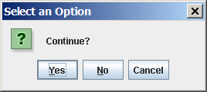
(GUI) Confirmation Dialogs
int option = JOptionPane.showConfirmDialog
(null, "Continue");

Slide 47
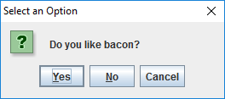
(GUI) Confirmation Dialogs
import javax.swing.JOptionPane;
public class ConfirmDialog1 {
public static void main(String[] args) {
int input = JOptionPane.showConfirmDialog(null, "Do you like bacon?");
// 0=yes, 1=no, 2=cancel
System.out.println(input);
}
}

